Slide 1
SHOP FOR HOME
TEAM MEMBERS:
RAAVI RAJA
MOHANACHARY NANDINI
ADDULAMALA MADHURI
VARANASI MADHURI

Slide 2
PROBLEM STATEMENT
Shop For Home is a popular Store in the market for shopping the home décor stuff . Due to Covid 19 all the offline shopping stopped. So, the store wants to move to the cloud platforms and wants their own web application.
CONTRIBUTION TO PROJECT :
Raavi Raja – worked on Frontend development
Varanasi Madhuri – worked on Frontend development
Addulamala Madhuri - worked on Backend development
Mohanachary Nandini - worked on Backend development

Slide 3
SOFTWARES USED
1) FRONTEND :
Angular
Boot strap
Angular Material
2) BACKEND :
Spring tool suite
Postgresql

Slide 4
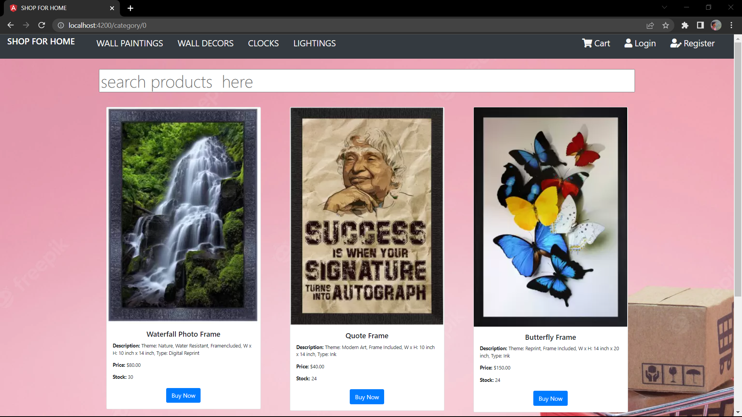
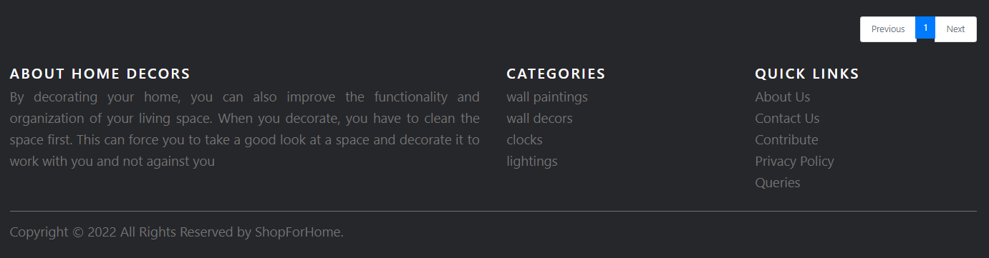
HOME PAGE OF WEBSITE

Slide 5
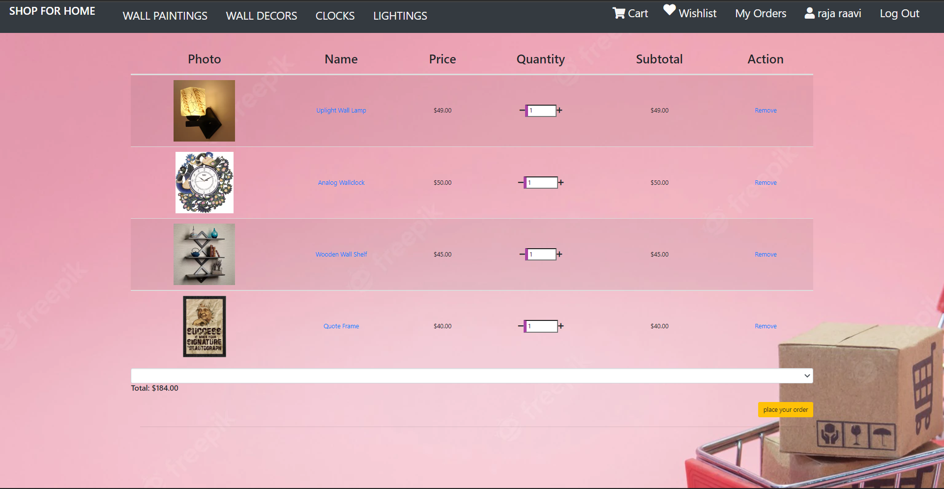
CART OPTION

Slide 6
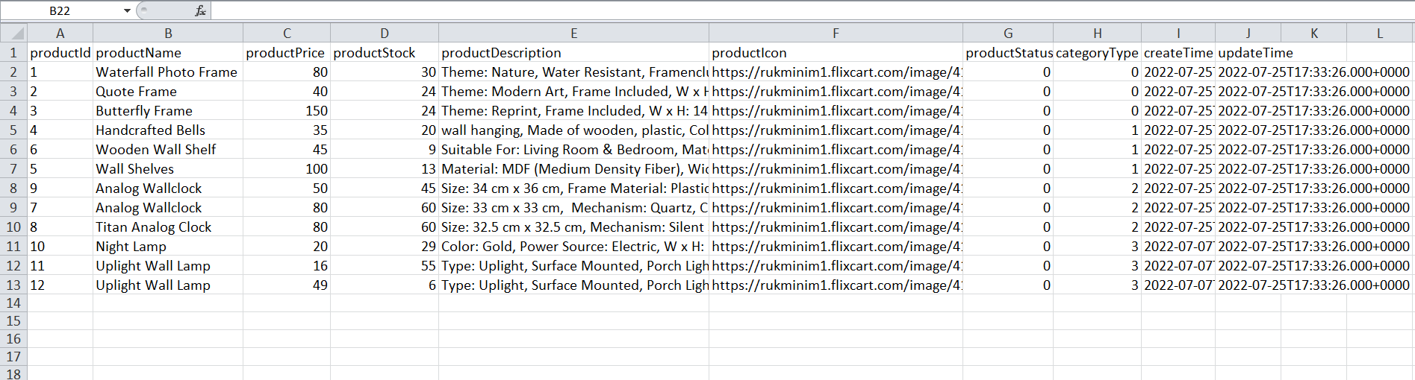
STOCK AND SALES REPORT

Slide 7
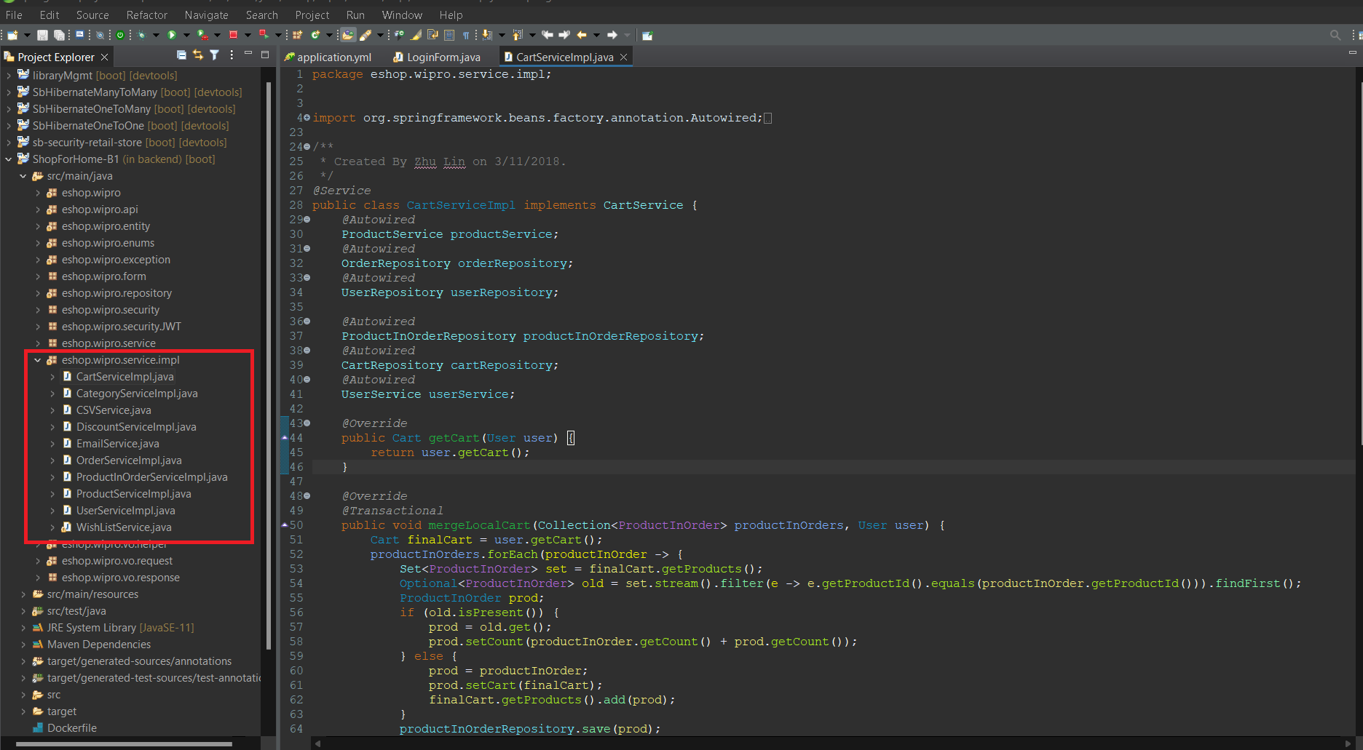
SERVICE LAYER IMPLEMENTATION

Slide 8
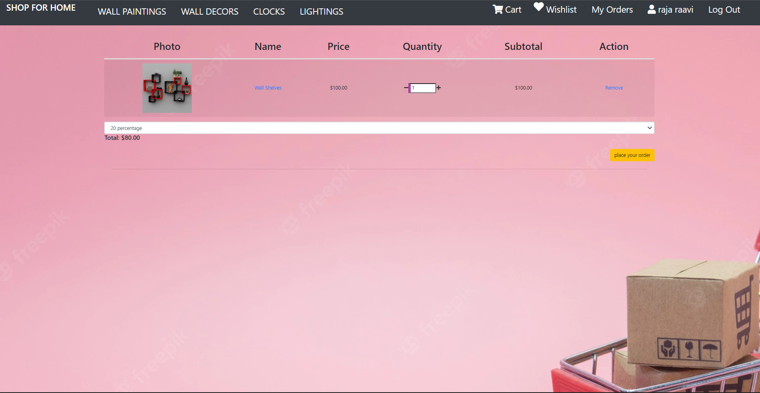
DISCOUNT MICROSERVICE

Slide 9
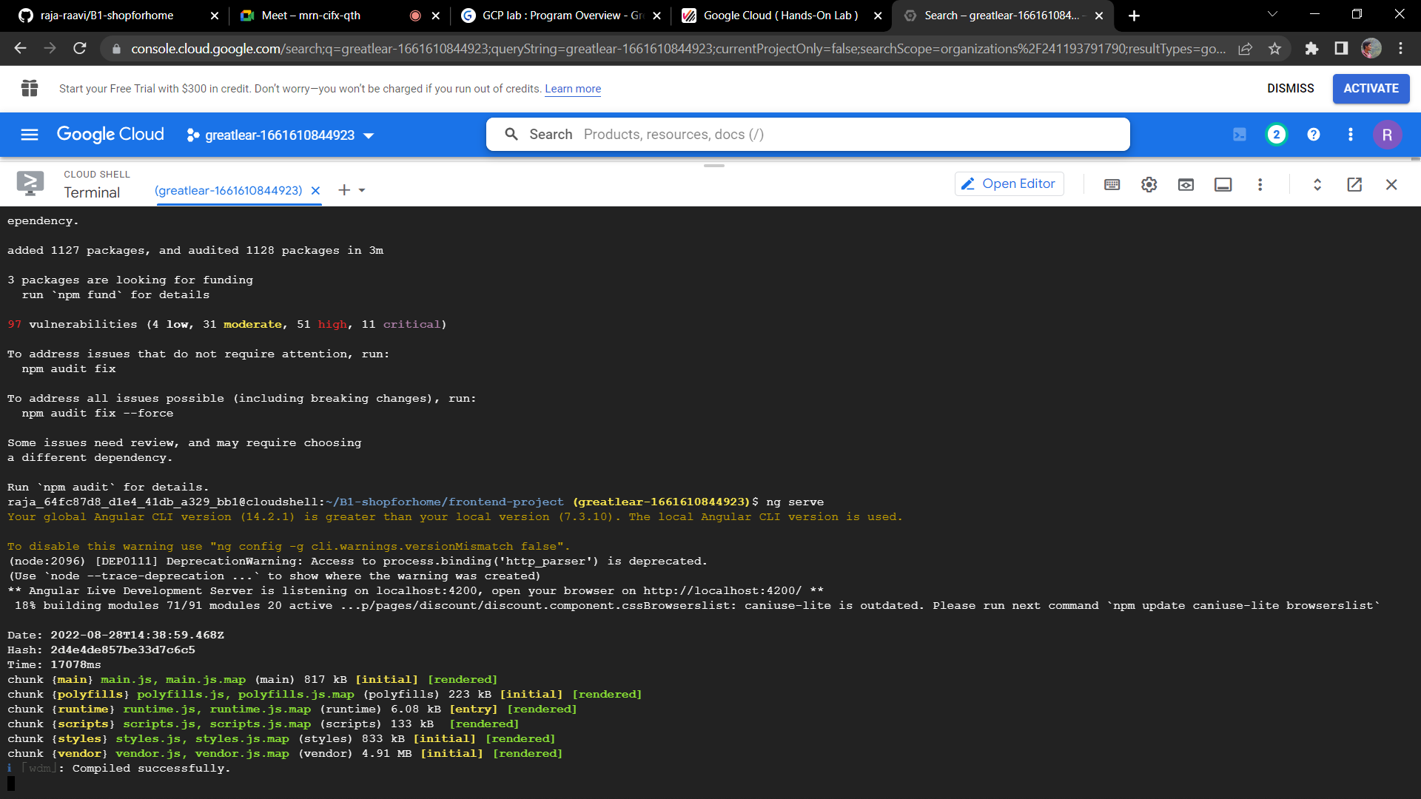
FRONTEND DEPLOYMENT ON VMS

Slide 10
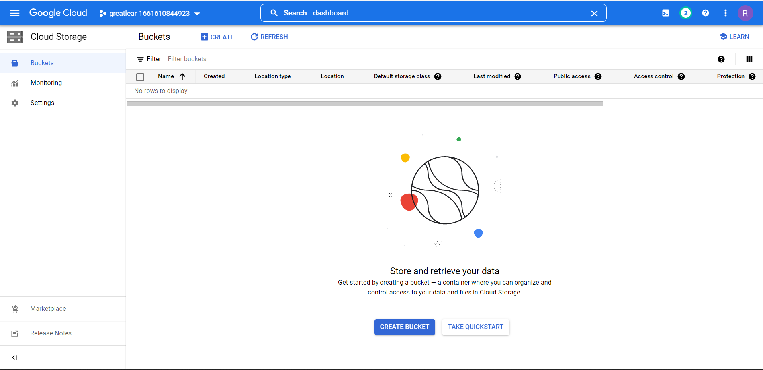
BACKEND DEPLOYMENT ON VMS (CREATING BUCKETS)

Slide 11
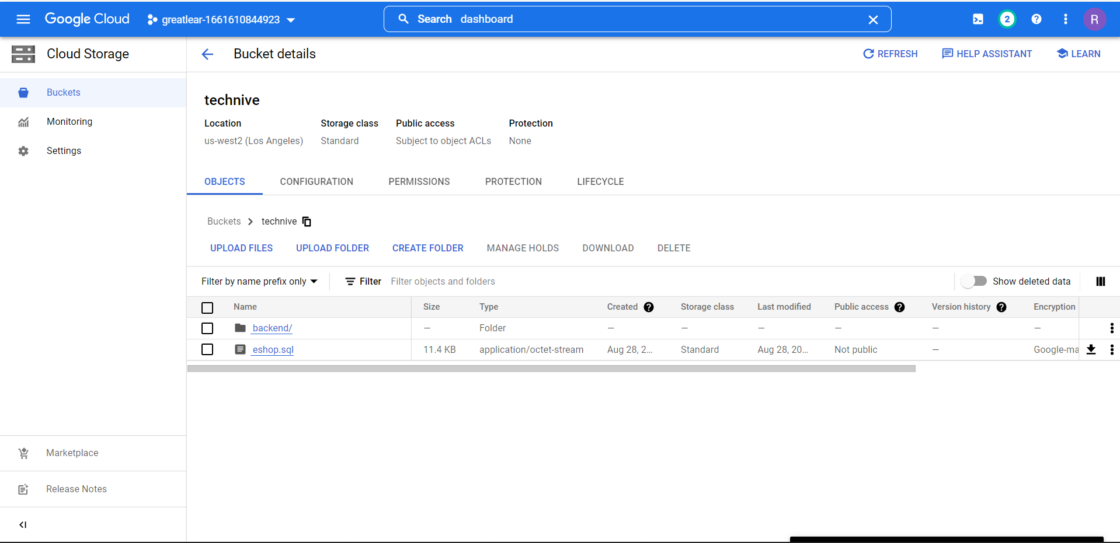
UPLOADING FILES INTO BUKETS (Cont…)

Slide 12
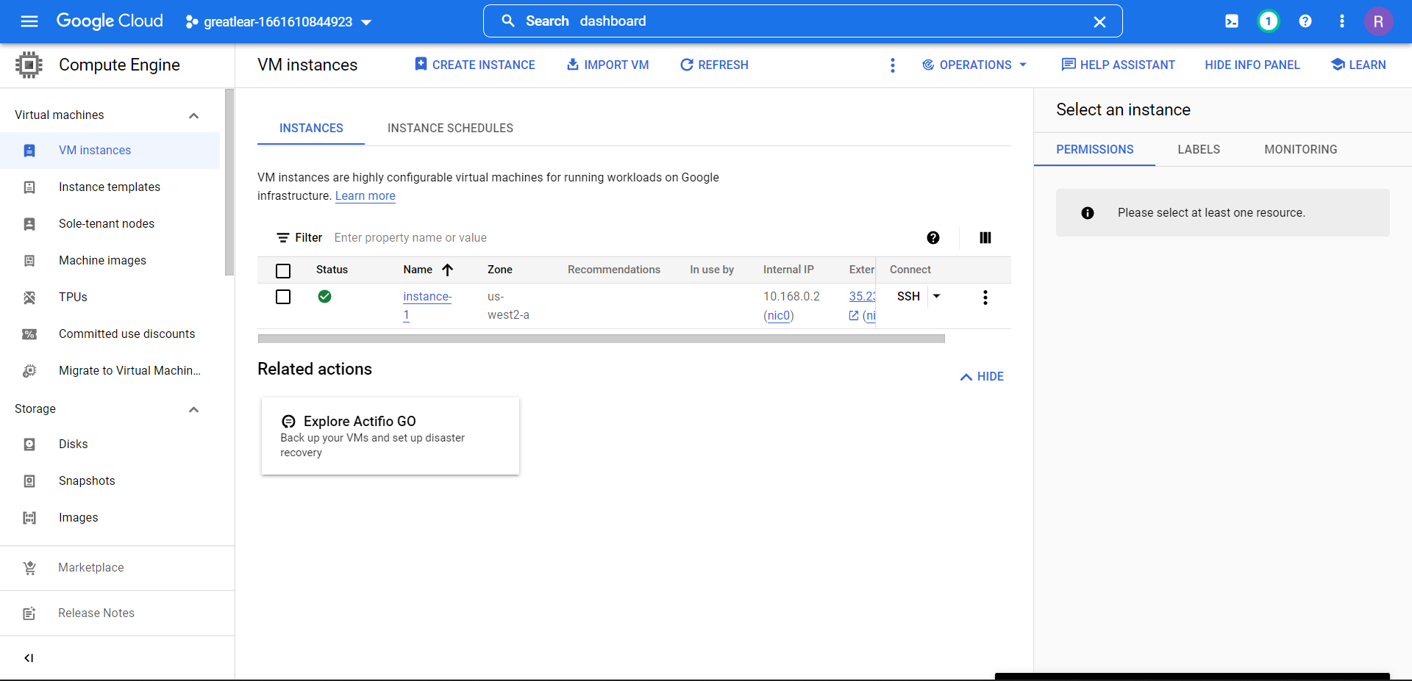
(Cont…)

Slide 13
CONCLUSION
Thus the Shop For Home web application is developed as the instructions
Since the nine objectives listed in sprint 2 document are all effectively implemented

Slide 14
THANK YOU

